Slide 1



My Probability Interactive Notebook
Name
Class
Teacher Mr Evans
Term 2 Semester 1
1

Slide 2
Create your own front page
It needs to contain the following –
My number interactive notebook
Name
Class
Teachers Name
Semester 1 Term 1
Page number 1

Slide 3
Contents
Glossary or Formula Page
Page
Date
Description
2
3

Slide 4
Tasks
24
7
30
Essential Question
Questions
Notes
Summary
4
5

Slide 5
24
7
30
Date
Tree Diagrams
EQ – When and why do we use Tree Diagrams?
Tree diagrams are useful for situations in stages. If one part occurs before another, or you can consider it like that, then a tree diagram is a useful way to visualise the problem.
When is it appropriate to use a tree diagram?
5

Slide 6
24
7
30
Date
Tree Diagrams
EQ – When and why do we use Tree Diagrams?
Tree diagrams are useful for situations in stages. If one part occurs before another, or you can consider it like that, then a tree diagram is a useful way to visualise the problem.
When is it appropriate to use a tree diagram?
For events involving removal of objects from a group, you need to decide whether or not the situation involves replacement. Tree diagrams where there is no replacement have fewer branches at each stage. Those involving replacement have the same number of branches at each node.
5

Slide 7
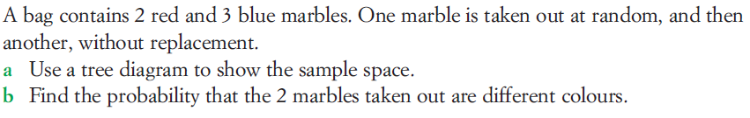
24
7
30
Date
Tree Diagrams
EQ – When and why do we use Tree Diagrams?
Tree diagrams are useful for situations in stages. If one part occurs before another, or you can consider it like that, then a tree diagram is a useful way to visualise the problem.
When is it appropriate to use a tree diagram?
For events involving removal of objects from a group, you need to decide whether or not the situation involves replacement. Tree diagrams where there is no replacement have fewer branches at each stage. Those involving replacement have the same number of branches at each node.
Example.
5

Slide 8
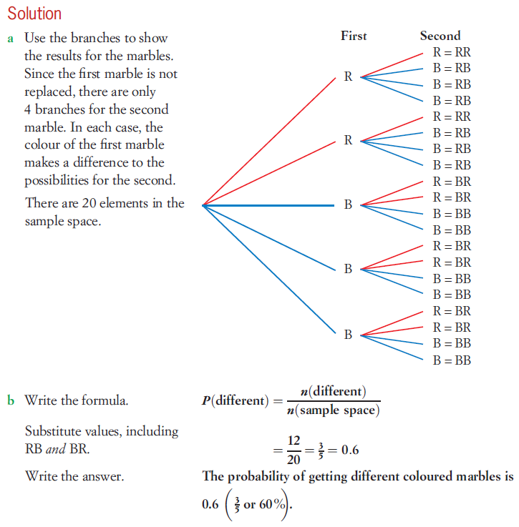
24
7
30
Date
Tree Diagrams
EQ – When and why do we use Tree Diagrams?
When is it appropriate to use a tree diagram?
5

Slide 9
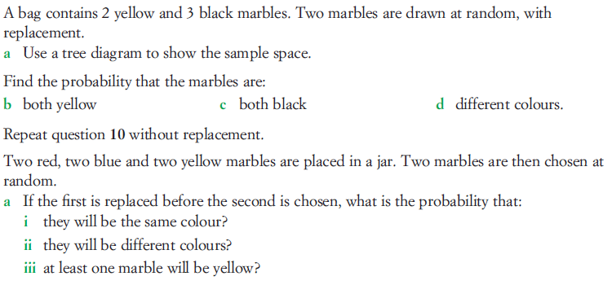
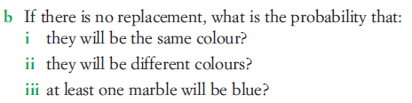
Task

Slide 10
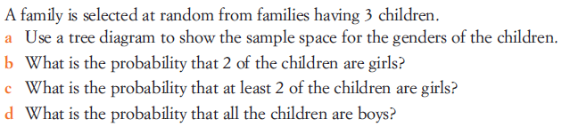
Task

Slide 11
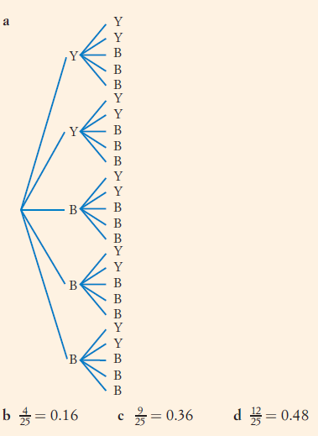
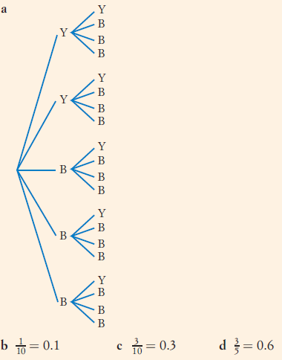
Answers

Slide 12
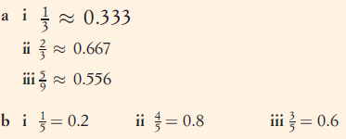
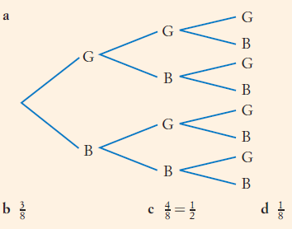
Answers

Slide 13
Notes Review
24, 7 ,30
Date
Title
Essential question
Notes complete
Notes complete with colour and diagrams
Questions completed
Contents page filed in
Formula page filled in

Slide 14
Homework
Review your notes and write a summary answering the essential question.

